Slide 1
Decoding
Beyond Binge-Watching and Captivating Audiences: The Story of Netflix's Advertising Triumph

Slide 2

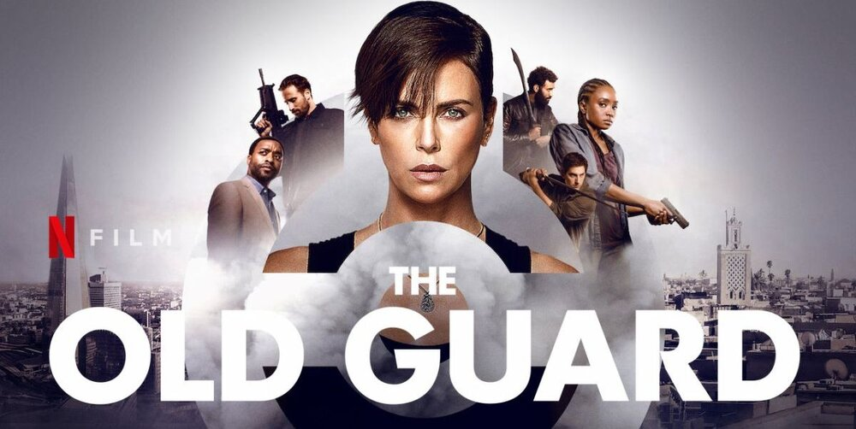
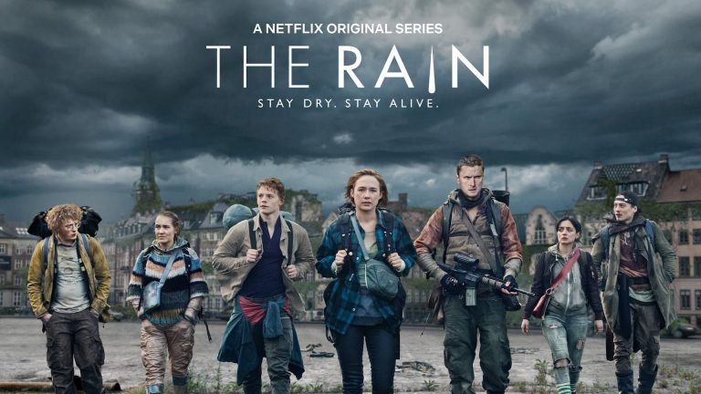

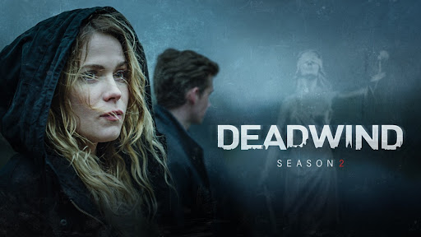
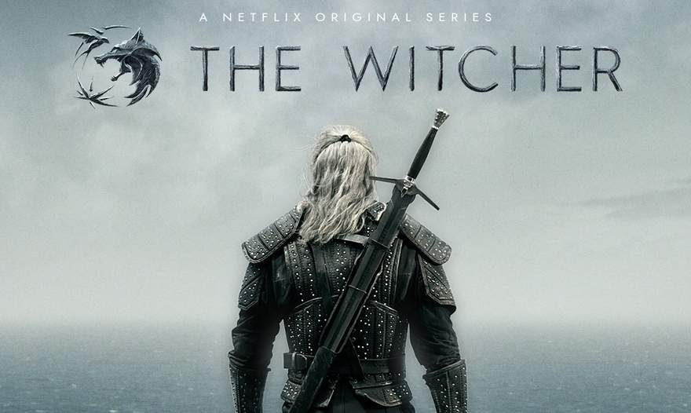


Have you ever wondered how Netflix customizes the content you watch and capitalizes the audience? In this presentation, we will analyse the advertising strategy, marketing efforts, customer interactions, and other methods employed by Netflix.
So let's get right into it.

Slide 3

WHAT IS
One of the top subscription streaming services, which lets users view a huge selection of TV series, films, documentaries, and more on a range of internet-connected devices. It was founded in 1997 by Reed Hastings and Marc Randolph in Los Gatos, California. Initially, it operated as a DVD-by-mail service, but later it shifted its focus to streaming media.
Notes:
Photo by JESHOOTS.com from Pexels

Slide 4

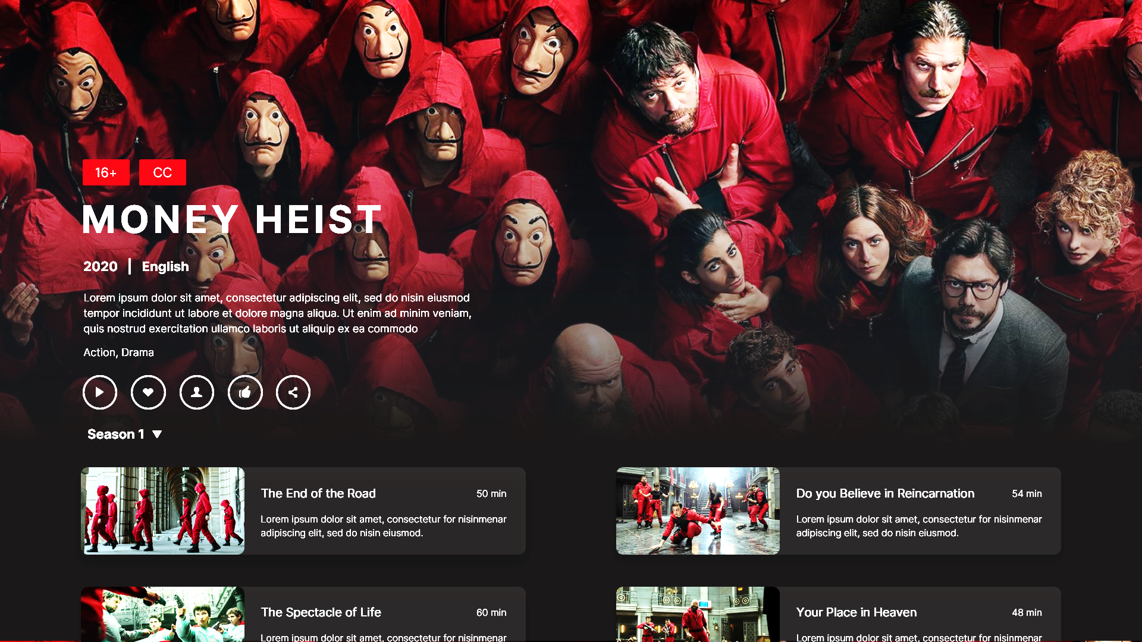
Reed Hastings and Marc Randolph launched Netflix, an American entertainment company, in Scott Valley, California, on August 29, 1997. When the business first began, customers could rent DVDs online and have them delivered to their homes through a DVD rental-by-mail service. It debuted a monthly subscription plan in 1999, which turned out to be a critical turning point in the business's history.
When Netflix introduced streaming media in 2007, it allowed users to view a variety of movies and TV series on their computers instantaneously. The business kept making significant content investments and signed licensing agreements with numerous networks and studios.
HISTORY
Netflix started creating original material in response to the growing demand for streaming. The political drama series "House of Cards" was the first to be produced in 2013, and it was much praised by critics and contributed to Netflix's rise to prominence in the entertainment sector.
Netflix has maintained its position as the top international streaming provider by concentrating on creating original content over the years, including TV shows, movies, and documentaries. It launched operations abroad in a number of nations and areas, serving a wide range of customers worldwide.
Notes:
slidesppt.net

Slide 5


Timeline From The Origin
2015-2016
1997
2009
Netflix introduces streaming, allowing subscribers to instantly watch TV shows and movies on their personal computers.
Global expansion accelerates with Netflix becoming available in numerous countries, including Australia, Japan, and parts of Europe.
and later expanded its service to over 130 new countries, making its streaming service available almost worldwide.
Reed Hastings and Marc Randolph found Netflix, initially as a DVD-by-mail rental service, offering a large selection of DVDs for rent through the mail.
Monthly subscription service introduced, allowing customers to keep DVDs without a due date and with no late fees.
Expansion of streaming service to Canada marks Netflix's first step in international expansion.
The company surpasses 100 million subscribers globally.
2017
2010
2007
Notes:
https://www.pexels.com/photo/abstract-analog-art-camera-390089/

Slide 6

Current Situation
An estimate of Netflix's net worth placed it at $230 billion.
Its large subscriber base—more than 200 million customers globally—had an impact on its worth.
Netflix persisted in creating a wide spectrum of original programming, encompassing well-known titles like "The Crown," "Stranger Things," "Money Heist," "Bridgerton," and "The Witcher.“
Due to intense competition from other streaming services like Disney+, Amazon Prime Video, and HBO Max, the company has been putting a lot of effort into producing interesting and varied original content.
Netflix has made significant strides in expanding its worldwide reach, offering its services to a wide range of national and international audiences across several countries and regions.
Notes:
Photo by Kyle Loftus from Pexels

Slide 7
AVAILABILITY
There were more than 190 countries where Netflix was accessible. To appeal to a wide range of worldwide audiences, the corporation has made considerable efforts to broaden its global reach by adapting its material to other languages and cultures.

Slide 8




How Does Netflix Plan its Advertising Campaign?
Research and Analysis
Goal Setting and Strategy Development
Creative Conceptualization and Content Development
Media Planning and Execution
Utilize data analytics to gather insights on audience demographics, viewing habits, and content preferences.
Analyze competitor strategies and industry benchmarks to identify opportunities and challenges.
Conduct focus groups, surveys, and consumer interviews to gather qualitative feedback and validate hypotheses.
Establish specific goals such as increasing subscriber growth, promoting new content releases, or enhancing brand awareness.
Develop a comprehensive strategy that aligns with the overall marketing objectives and target audience insights.
Determine the budget allocation and resource allocation for each aspect of the campaign.
Collaborate with creative agencies, directors, and content creators to brainstorm ideas and develop compelling narratives.
Create visually captivating advertisements, trailers, and promotional materials that showcase Netflix's content offerings.
Tailor messaging and imagery to different audience segments and marketing channels for maximum impact.
Utilize a mix of traditional and digital media channels, including TV, online video platforms, social media, and outdoor advertising.
Optimize media placement and scheduling to maximize reach, frequency, and engagement.
Implement targeted advertising campaigns based on audience segmentation, geographic location, and behavioral targeting.

Slide 9
How
Unleashing Netflix’s Campaign Strategy
How does Netflix perform its Creative Execution?
organize and carry out its “UNLIMITED ENTERTAINMENT” marketing campaign, and what are the implications on both the viewership and Netflix itself?
Impact and result of Advertising Campaign on Netflix.
Notes:
slidesppt.net

Slide 10





Unleashing Netflix’s Campaign Strategy
Research and Insights
Creative Concept
Multichannel Approach
Personalized Messaging
Notes:
Photo by fauxels from Pexels

Slide 11

Netflix conducted extensive market research to understand shifting consumer behaviors and preferences post-pandemic. Insights revealed an increased demand for diverse content options and a desire for escapism and entertainment amid ongoing uncertainties.
Research and Insights
Leveraging the insights, Netflix crafted a creative concept centered around the theme of "Unlimited Entertainment." The campaign emphasized Netflix's vast library of content spanning across genres, languages, and formats, offering something for everyone.
Creative Concept
Notes:
slidesppt.net

Slide 12
Netflix adopted a multichannel approach to reach audiences across various touchpoints. The campaign encompassed TV commercials, digital ads, social media activations, outdoor billboards, and influencer partnerships to maximize visibility and engagement.
Multichannel Approach
Netflix tailored messaging to resonate with different audience segments, highlighting curated recommendations based on viewing history and preferences. This personalized approach aimed to enhance relevance and connect with viewers on a more emotional level.
Personalized Messaging
Notes:
slidesppt.net

Slide 13




How does Netflix perform its Creative Execution?
TV Commercial
Digital and Social Campaign
Outdoor Billboards
Influencer partnership
Notes:
Photo by fauxels from Pexels

Slide 14
Netflix rolled out visually captivating TV commercials showcasing snippets of popular shows and movies available on the platform. The ads conveyed the message of "Unlimited Entertainment" by depicting the diverse range of content accessible to subscribers.
TV Commercial
Engaging digital ads and social media activations featured user-generated content, interactive quizzes, and behind-the-scenes glimpses of Netflix originals. Hashtag campaigns encouraged user participation and generated buzz around upcoming releases.
Digital and Social Media Campaign
Notes:
slidesppt.net

Slide 15
Strategic placement of outdoor billboards in high-traffic areas reinforced Netflix's brand presence and reminded audiences of the platform's offerings. Bold visuals and concise messaging captured attention and drove curiosity among passersby.
Outdoor Billboards
Netflix collaborated with influencers and content creators to amplify the campaign's reach and authenticity. Influencers shared personalized recommendations and exclusive content, leveraging their influence to drive engagement and subscriptions.
Influencers Partnership
Notes:
slidesppt.net

Slide 16



Impact and result of Advertising Campaign on Netflix.
Increased Brand Awareness
Subscriber Growth
Positive Audience Reception
Industry Recognition
Notes:
Photo by fauxels from Pexels

Slide 17
Netflix's "Unlimited Entertainment" campaign successfully heightened brand awareness and strengthened Netflix's positioning as the premier streaming platform offering unparalleled entertainment options.
Increase Brand Awareness
The campaign contributed to a notable increase in subscriber growth, with a surge in new sign-ups and higher retention rates among existing subscribers. The personalized messaging and diverse content offerings resonated well with audiences, driving conversion and loyalty.
Subscriber Growth
Notes:
slidesppt.net

Slide 18
Audiences responded positively to the campaign, expressing enthusiasm and appreciation for Netflix's extensive content library and user-centric approach. Social media sentiment analysis indicated a high level of engagement and advocacy among viewers.
Positive Audience Reception
Netflix's "Unlimited Entertainment" campaign garnered industry recognition and accolades for its innovative approach and impactful storytelling. The campaign set a benchmark for excellence in advertising within the streaming entertainment sector.
Industry Recognition
Notes:
slidesppt.net

Slide 19
How
Interacts with its audience on different social media platforms ?
Notes:
slidesppt.net

Slide 20
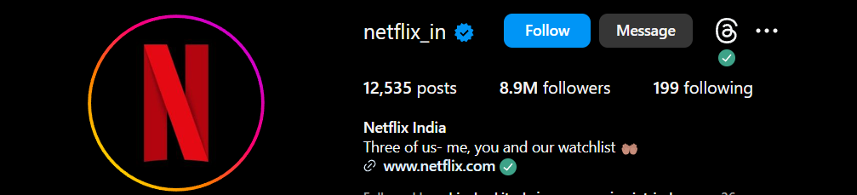
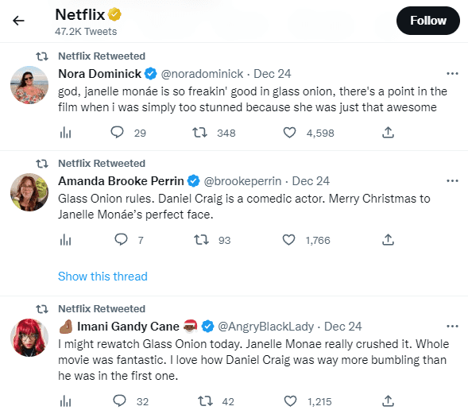
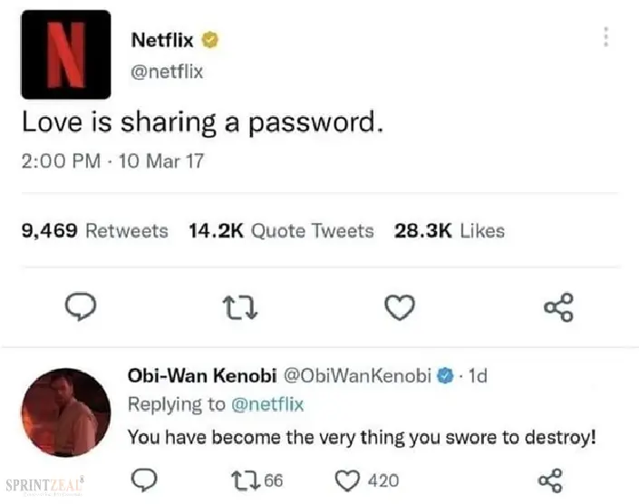
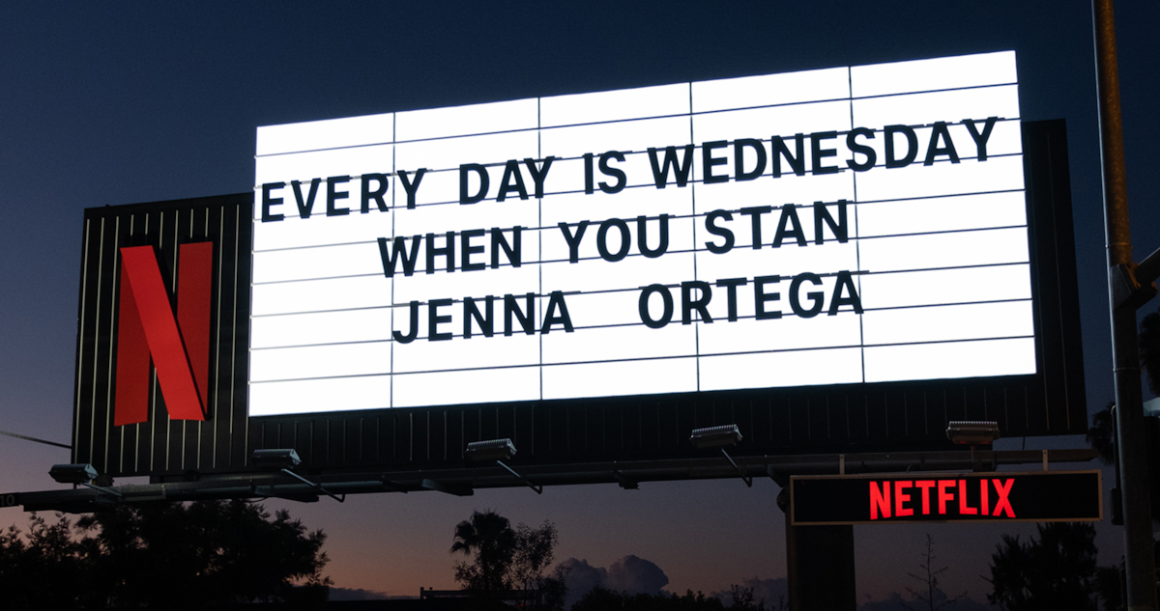
Twitter Admin retweeted the audience’s tweets.
Netflix’s Instagram handle has over a whopping 8.9 million followers.
Netflix’s Billboard on their horror-comedy series “WEDNESDAY” protagonist played by Jenna Ortega.
Twitter Admin interacts with the audience on Twitter.

Slide 21
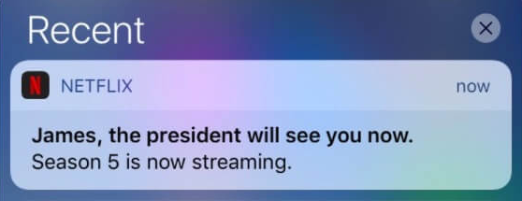
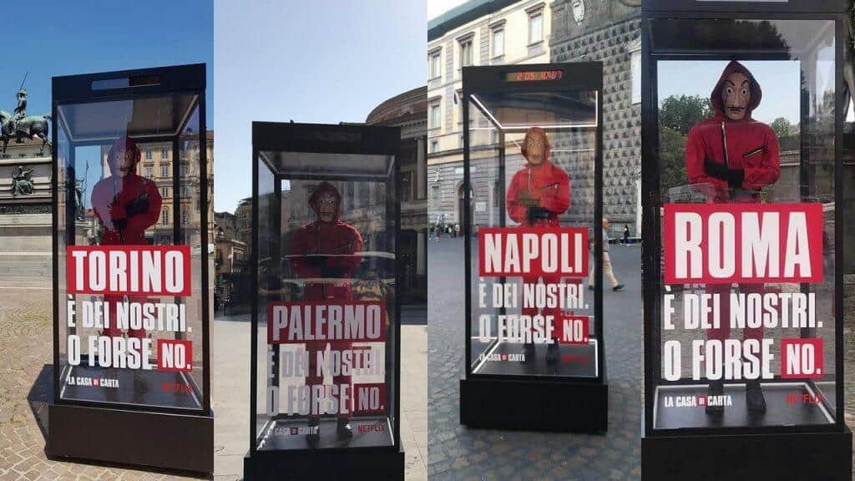
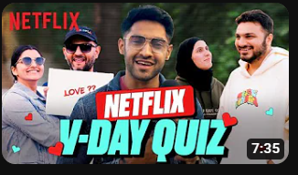

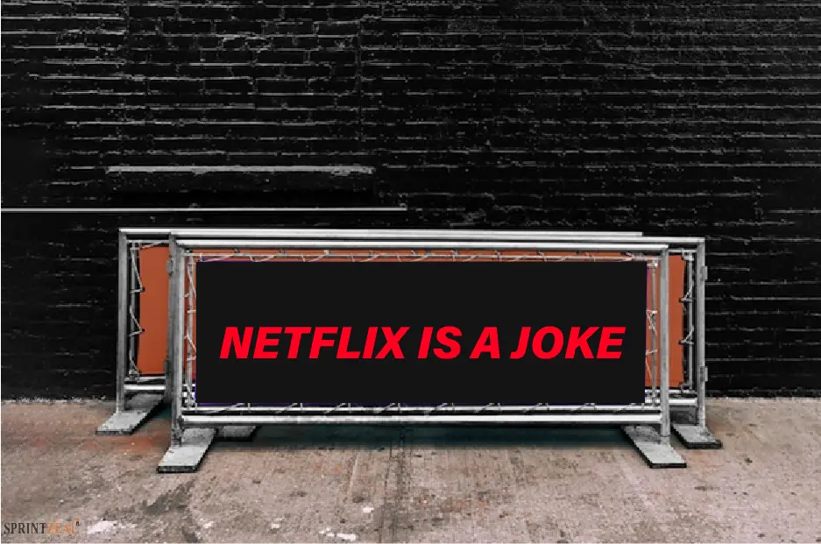
Dummies of the Money Heist statues are placed in the market to gauge public response. That is a component of Gurriela's advertising.
Collaborating with the content creator for roadside interviews with the audience.
Netflix sends personalized notifications to their customers.
Partnership with content creators and influencers to make engaging content for all types of audiences.
Netflix creating a buzz of marketing.

Slide 22

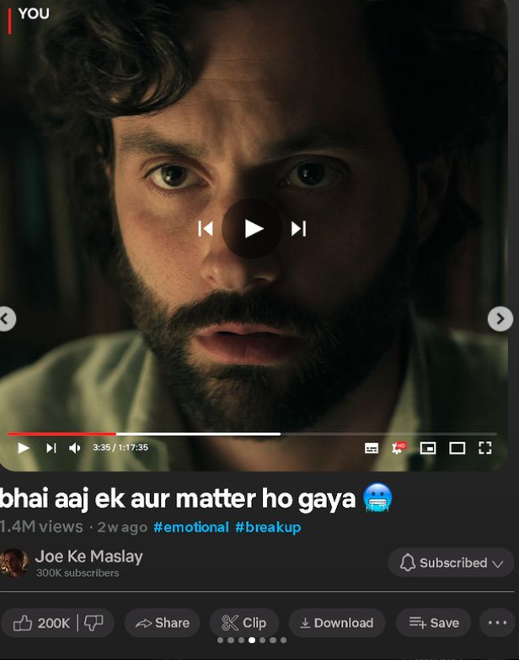
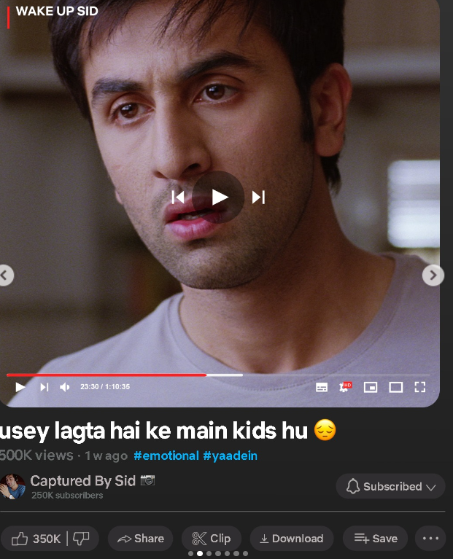
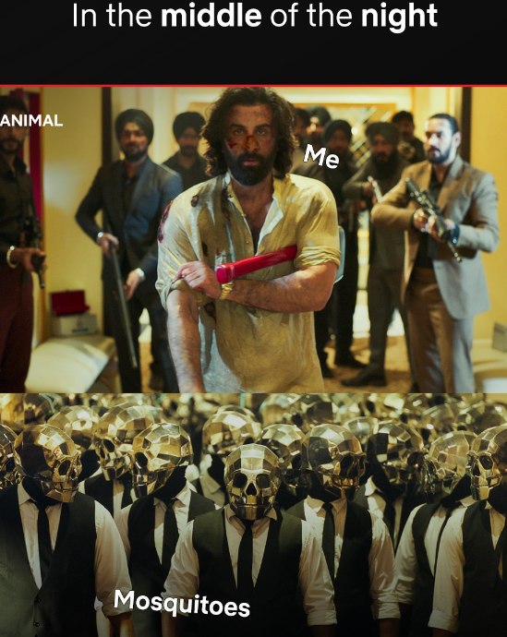

To pique viewer’s interest as they engage with one another on social media, Netflix employs Copywriters to create these kinds of captivating posts.

Slide 23
In conclusion, Netflix's "Unlimited Entertainment" campaign exemplifies the synergy of strategic marketing and creative storytelling in cementing the platform's dominance in the streaming industry. By tapping into post-pandemic consumer sentiments and leveraging its vast content library, Netflix successfully positioned itself as the ultimate destination for diverse entertainment experiences. The campaign's multichannel approach, personalized messaging, and engaging content resonated with audiences, resulting in increased brand awareness, subscriber growth, and positive reception.
Moreover, the campaign's industry recognition underscores Netflix's commitment to innovation and excellence in advertising. Moving forward, Netflix's "Unlimited Entertainment" campaign serves as a testament to the power of storytelling in driving audience engagement and loyalty. As the entertainment landscape continues to evolve, Netflix remains poised to lead the charge, delivering unparalleled entertainment experiences that captivate and inspire audiences worldwide.
Conclusion
Notes:
slidesppt.net

Slide 24

Thank You
Notes:
Photo by Andrea Piacquadio from Pexels

